Slide 1

Stochastic Volatility
By Adam Messina, Sathish Komire and Siddarth Maredu

Slide 2

Agenda
Model Introduction
Foreign Exchange Rates Introduction
Simulated Example
Fitting The Model To Data
Conclusion
Q/A

Slide 3
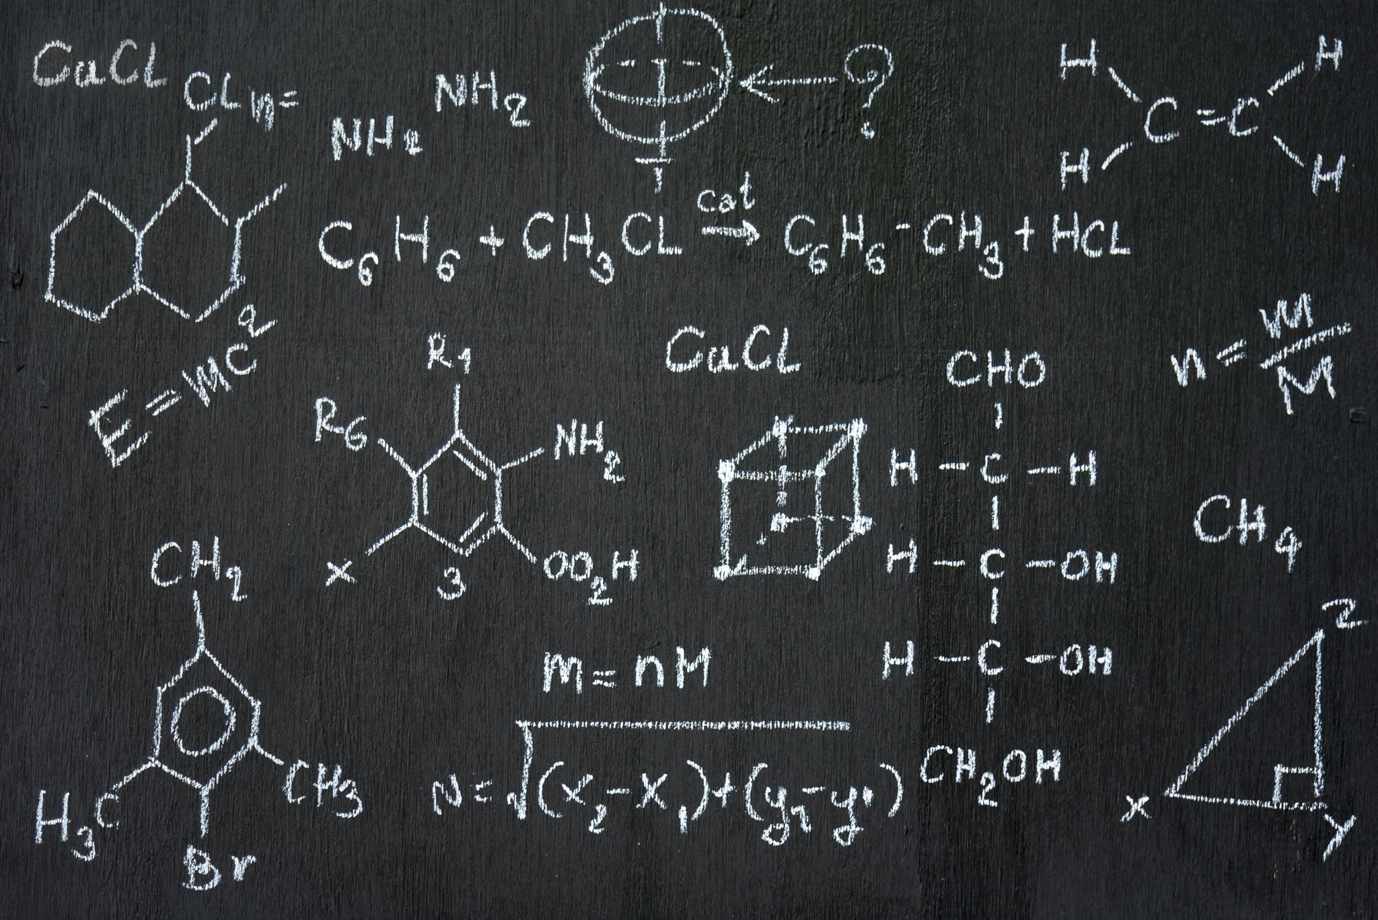
Model Introduction
State-space Model
Observation
State-Space Equation
Bayesian Inference
Draws From Posterior Distribution of Parameters and Latent Variables
Used in Finance To Predict Future Volatility of Time-Series

Slide 4
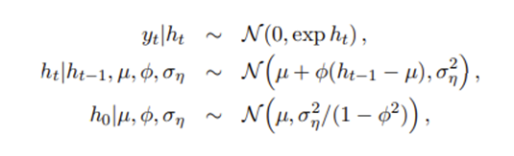

Model Introduction: Equation
Random Vector of Returns with Mean Zero: y = (y1, y2, . . . , yn) ^T
Each Observation Has Its Own Variance: e^ht
Centered Parameterization:
N (µ, σ2 η ) denotes the normal distribution with mean µ and variance σ2 η.
Theta is refered to as the vector of parameters (θ = (µ, φ, ση) ^T)
The process h = (h0, h1, . . . , hn) is an unobserved and interpreted as the log-variance process or time-varying volatility process.

Slide 5
Model Introduction: Prior Distribution
The model specifies a prior distribution for the parameter vector θ where each component can be independent and follow a different distribution such that p(θ) = p(µ)p(φ)p(ση).
p(µ) = level of log-variance
p(φ) = persistence of log-variance
p (ση) = volatility of log-variance
Each parameter has it's set of hyperparameters:
µ ∼ N (bµ, Bµ)
(φ + 1)/2 ∼ B (a0, b0)
σ 2 η ∼ Bση × χ 1^2 = G (½, 1/2Bση)

Slide 6

Model Introduction: stochvol
stochvol is the R package used to forecast future volatilities.
Key Functions:
svsim(len, mu, phi, sigma)
svsample(y, priormu, priorphi, priorsigma)
volplot(x, forecast, dates)

Slide 7
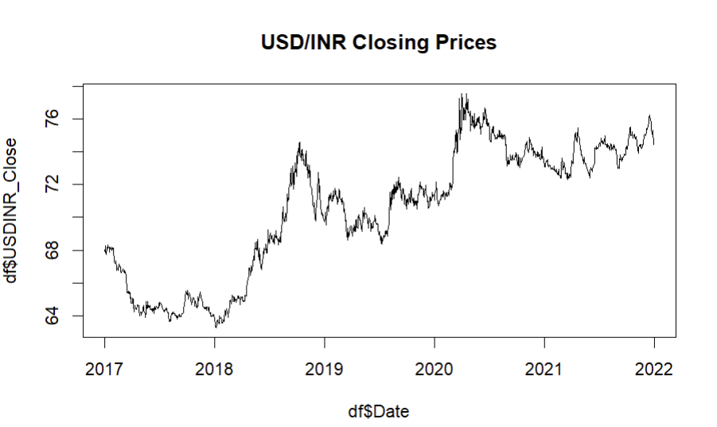
Foreign Exchange Rates (daily updates) – Yahoo!
Daily time series of FX rates from Kaggle for Stochvol
Focused on USDINR_Close for univariate time series forecasting
EDA
No Null Values
Duplicates handling by imputing with mean
Filtered for 2017-2021 data

Slide 8
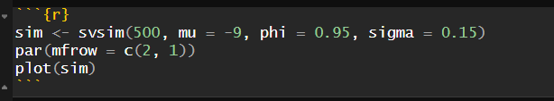
Simulated Example
First, we have simulated a time series data with 500 observations and arbitrary values of mean, phi and sigma using svsim() function from stochvol package in R.

Slide 9
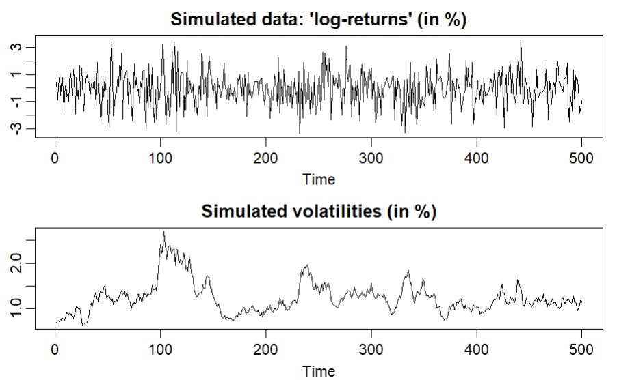
Simulated Data log returns and volatilities

Slide 10
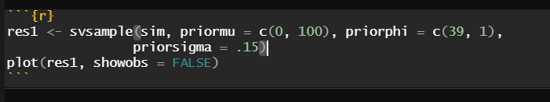
Simulated Example Contd..
And then with simulated data, we proceeded to infer the model parameters with the svsample() function. We applied a Bayesian approach, incorporating prior beliefs to get posterior draws.

Slide 11
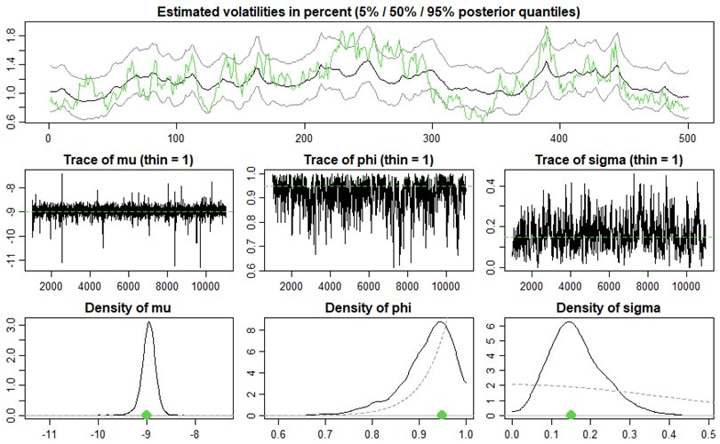
Trace Plot of Simulated Data

Slide 12
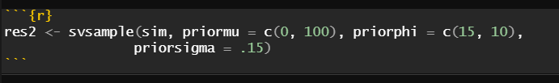
Simulated Example Contd..
So, we repeated the same plot with the different priorphi now.

Slide 13
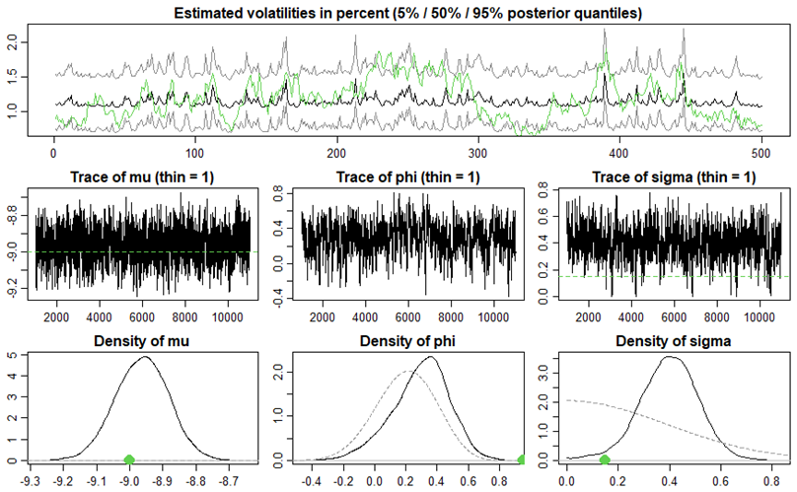
Trace Plot of Simulated Data

Slide 14
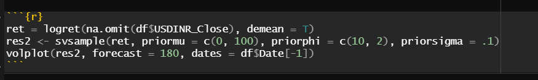
Fitting the model to data
So after careful observation from Bayesian Inference with simulated data, we fitted the model with our original foreign exchange data with high priorPhi and tuning other prior beliefs.

Slide 15
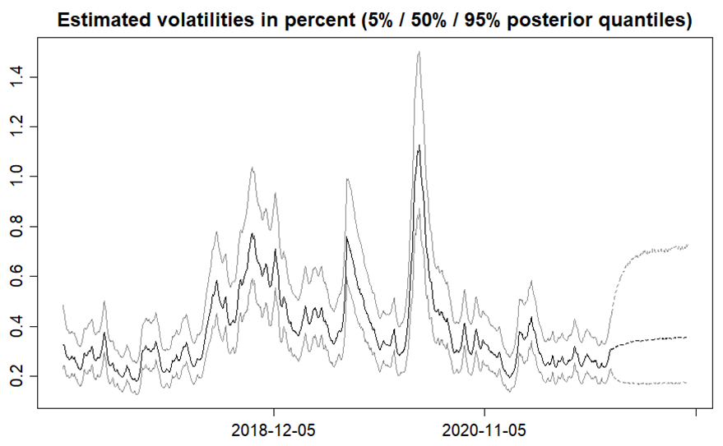
Volatility Forecast

Slide 16

PROS
Capacity to build model that captures randomness.
Bayesian Inference for posterior draws using prior knowledge.
CONS
High significance of hyperparameters on the model.
UniVariate and MultiVariate
Requires domain knowledge on priors and model specifications for modelling expertise.

Slide 17

Conclusion
Thanks
Any Questions

